Slide 1
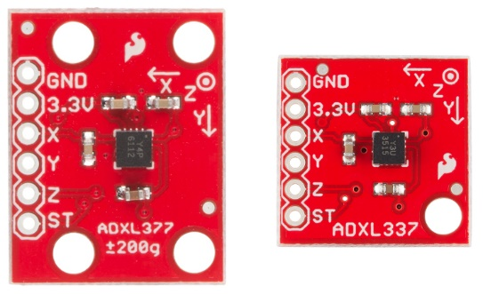
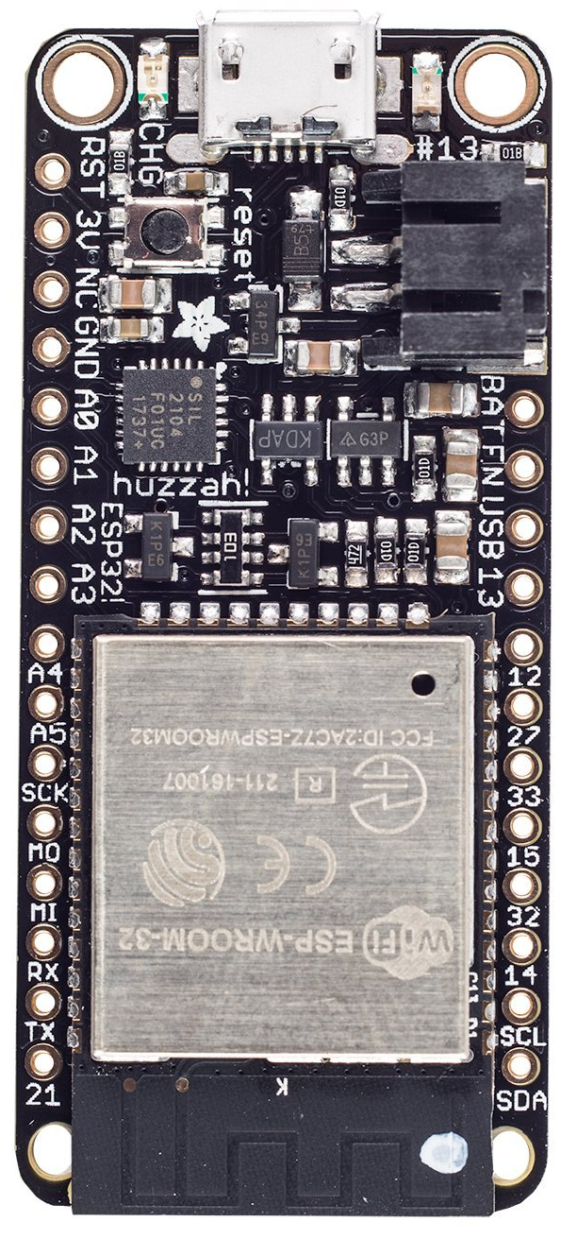
1) Solder headers to ADXL377
2) Place in soldering fixture
3) Solder headers to HUZZAH32

Slide 2
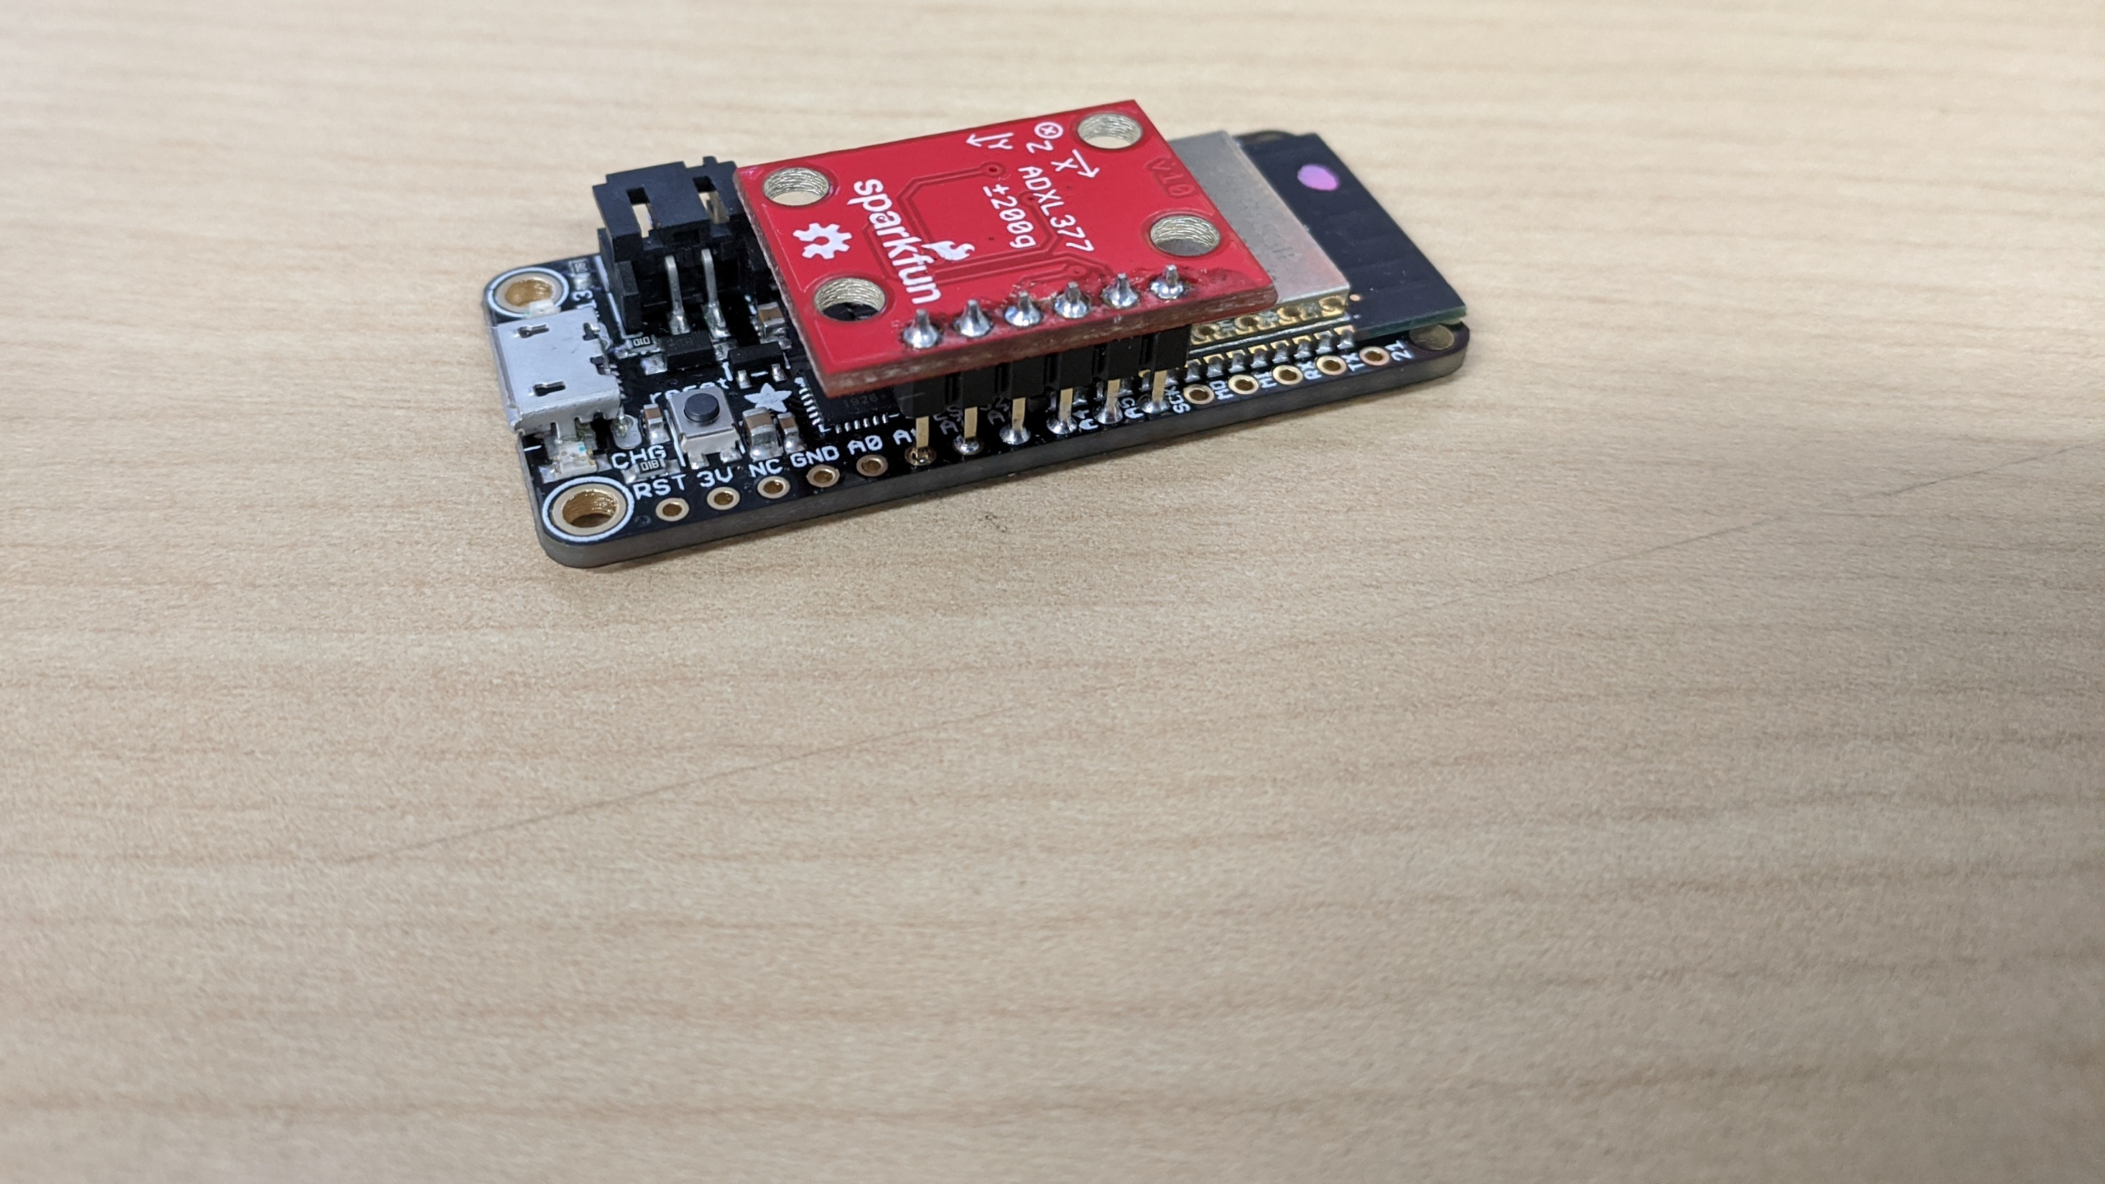
ADXL377 | HUZZAH32 | GPIO | Description
GND | SCK | 5 | Sink
3.3V | A5 | 4 | Source
X | A4 | 36 | ADC1
Y | A3 | 39 | ADC1
Z | A2 | 34 | ADC1
ST | A1 | 25 | Self Test

Slide 3
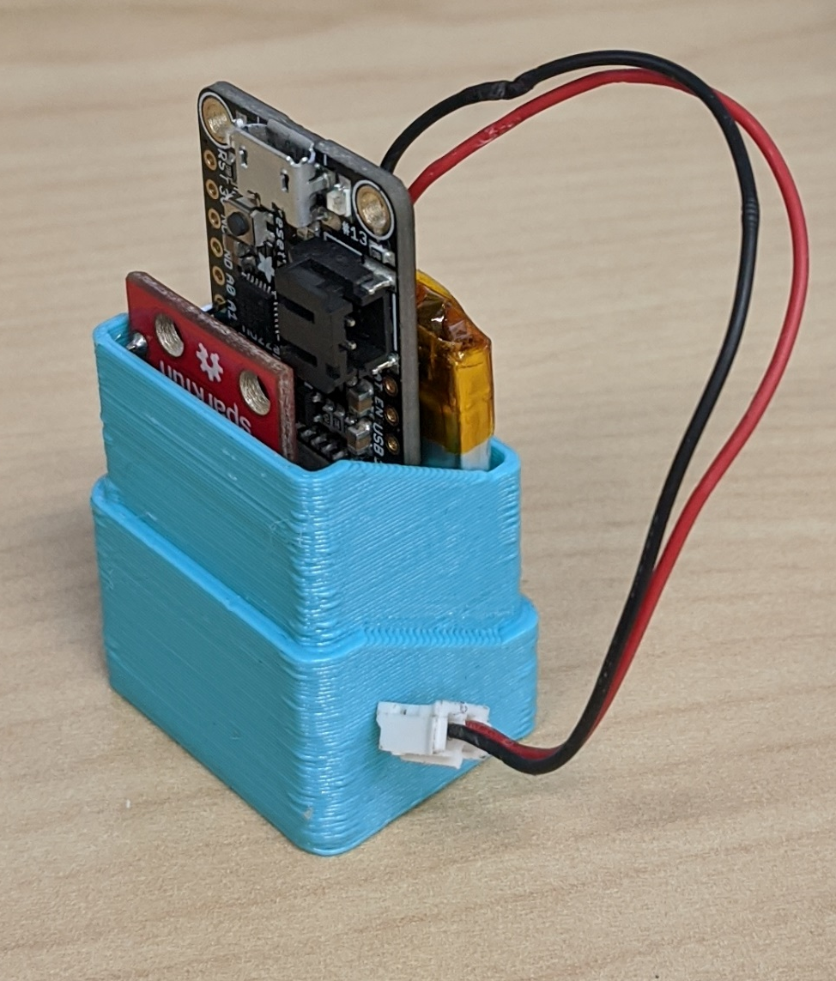
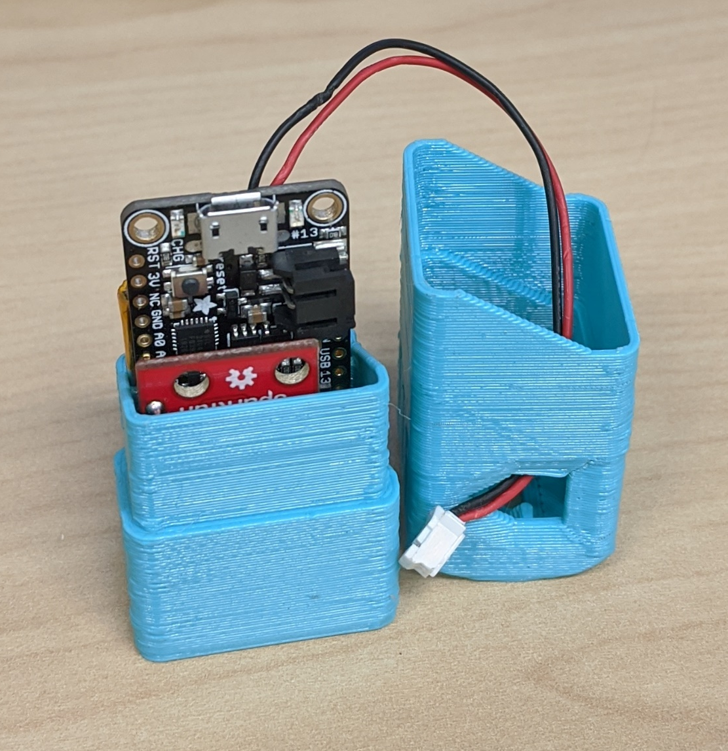
Insert PCB and Battery into appropriate slots
Components should be snug
Feed battery cable through the Yolk cap

Slide 4
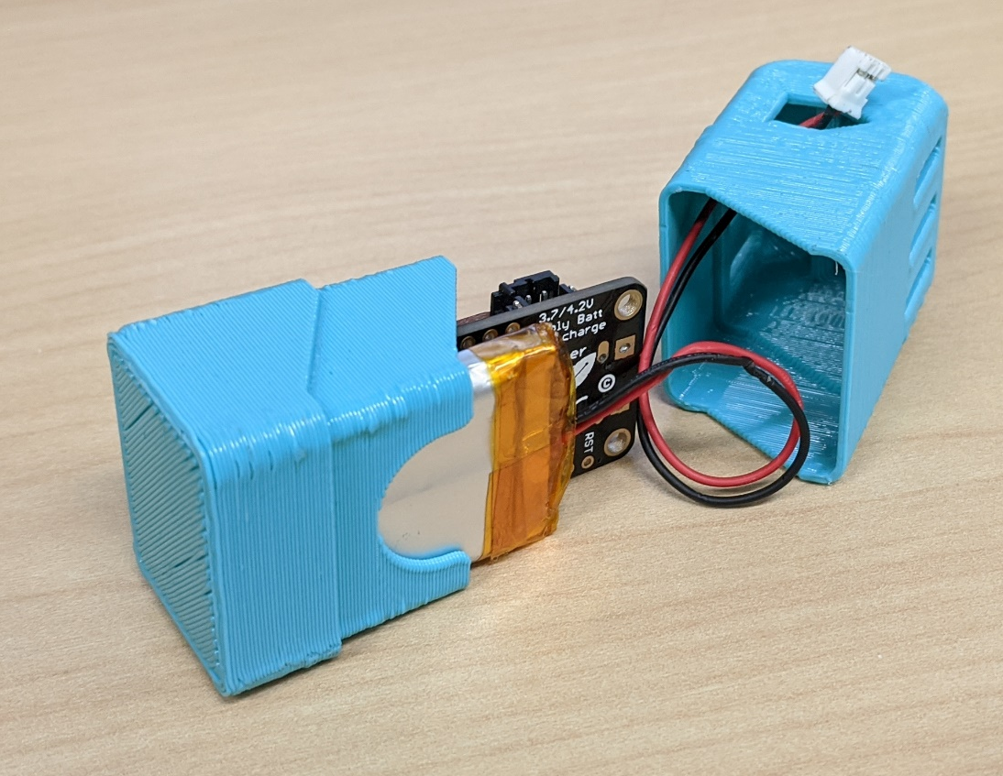
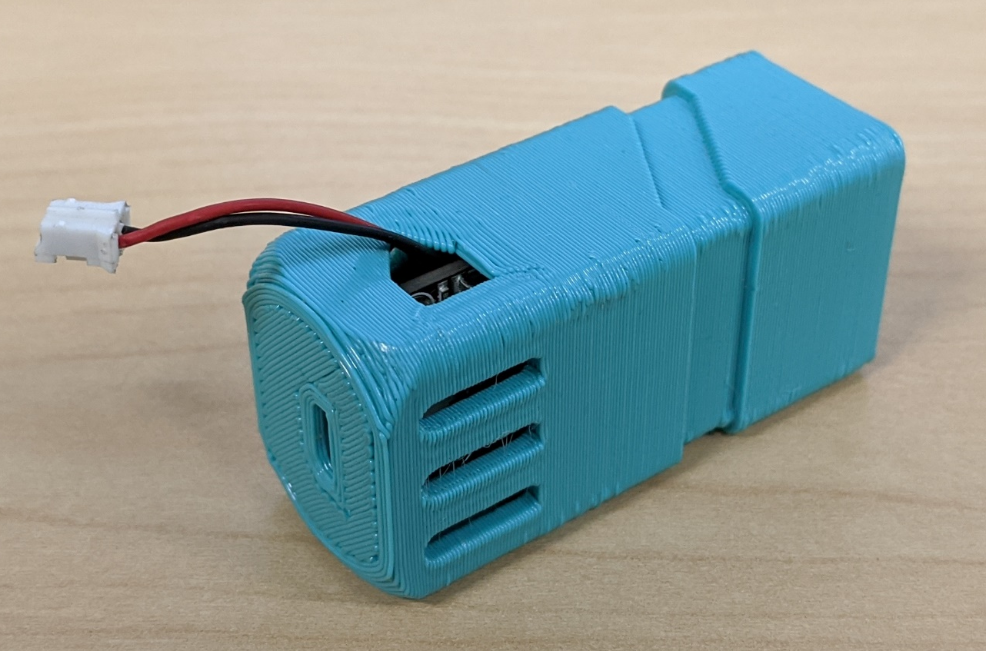
Rotate the cap to produce a loop in the battery cable.
This allows the cable to spool inside the Yolk.
Slide the cap onto the Yolk, making sure not to pinch the cable with the PCB

Slide 5
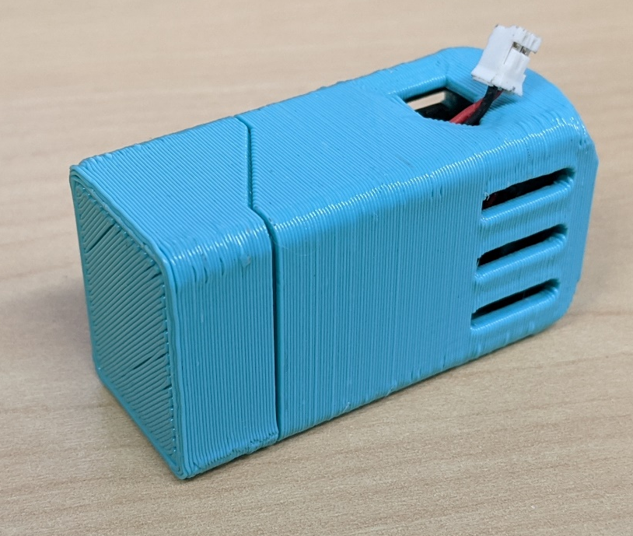
Tuck away the cable inside the Yolk

